Slide 1
Welcome to the scan

Slide 2

It is very important that you stay as still as possible
during the experiment in the MRI machine
If you need to move a bit or stretch, please do so between runs, when the scanner is not running.

Slide 3
Rating scale for the 1st task
Please rate HOW MUCH you want to avoid this experience in the future?
Not
at all
Most
Using the trackball in the scanner, you will be able to move the yellow bar left and right, and click a button to submit your rating.

Slide 4
Rating scale for the 1st task
Please rate HOW MUCH you want to avoid this experience in the future?
A little bit
Moderately
Strongly
Very strongly
Not
at all
Most
Not at all: “I feel no need to avoid this experience.”
A little bit: “I would put a little effort into avoiding this experience.”
Moderately: “I would prefer to avoid this experience in the future.”
Strongly: “I strongly want to avoid this experience in the future.”
Very strongly: “I very much want to avoid this experience.”
Most: “I never want to experience this again in my life”
Notes:
These markers indicate where your answer may lie, note that the scale appears without these markers during scanning, so please pay close attention…….the right end of the scale, ”most” represents the strongest imaginable amount of intensity, whereas ”very strongly” is where the intensity would become unbearable for you. Another way to look at this question is: how much money would you have to receive in order to experience this again in the future? At not at all, it would take no money at all, whereas at “most” there is no amount of money that could get you to experience this again.

Slide 5
Rating scale for the 1st task
Please rate HOW MUCH you want to avoid this experience in the future?
A little bit
Moderately
Strongly
Very strongly
Not
at all
Most
Q: Could you explain back to me how you understand the rating scale?

Slide 6
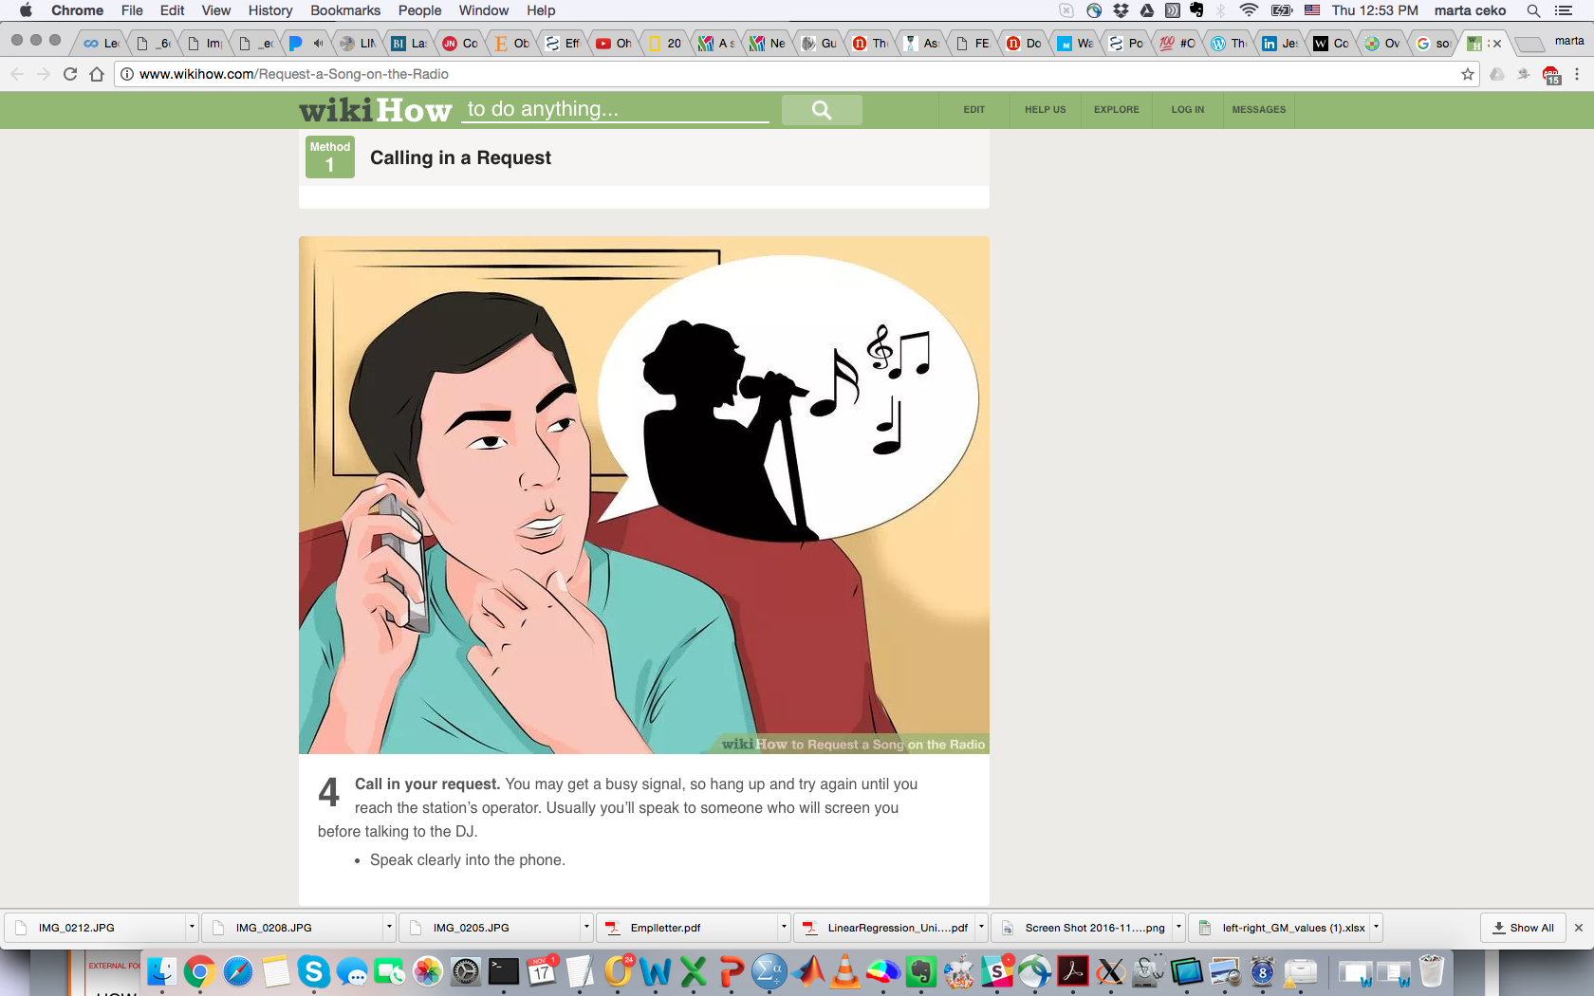
INTENSITY vs. UNPLEASANTNESS
INTENSITY:
HOW LOUD IS THE SONG?
(UN)PLEASANTNESS: HOW MUCH DO YOU LIKE OR DISLIKE THE SONG
Notes:
After some runs we will also ask you to rate the INTENSITY and the PLEASANTNESS OR UNPLEASANTNESS of the sensations you experienced in the scanner. We will always ask you about the STRONGEST sensation of each kind you experienced, as you might experience different levels of each stimulus and the strongest one is usually what we remember best.
These two rating scales (intensity and unpleasantness) don’t always go hand in hand. To give you an idea of the distinction between the two scales, I am going to give you an example. Imagine you are listening to a song on the radio.
I can ask you to rate how loud the song sounds or how pleasant or unpleasant it is to hear. So, here, the intensity is how loud it is and the pleasantness/unpleasantness is how much you like the song. You might find the song pleasant, but a family member might find this same song very unpleasant.
Please keep this distinction in mind when you rate the stimuli. Do you have any questions?

Slide 7
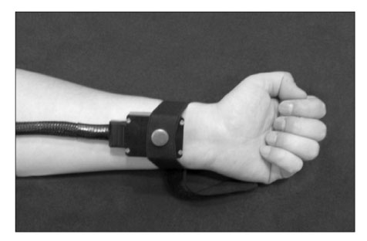
Rating scale INTENSITY
Barely detectable
Strong
Very strong
Weak
No sensation
Strongest imaginable
sensation
Q: Could you explain back to me how you understand the rating scale?
Notes:
Explain scale
So for example if we are talking about the heat stimuli you experienced on your palm – if the strongest heat you remember from that run was barely detectable you would rate it [here] and if it was a very painful heat, you would rate it [here] – point to very strong.
We will ask you this question for each type of stimuli you experience in the scanner – show pics
Wani, I am a bit worried that we might be confounding non-painful with painful sensations – I know you used this scale successfully for pain stimuli, do you think the explanation above is ok enough?
We don’t want to mention the word pain too much as we don’t want to bias them towards focusing on sensations being painful.

Slide 8
Rating scale UNPLEASANTNESS
Strongly unpleasant
Very strongly unpleasant
Weakly unpleasant
Barely unpleasant
Neutral
Strongest imaginable
unpleasantness
Q: Could you explain back to me how you understand the rating scale?
Notes:
Explain scale
So for example if we are talking about the heat stimuli you experienced on your palm – if the most unpleasant heat you remember from that run was just barely unpleasant you would rate it [here] and if it was a very unpleasant heat stimulus you would rate it [here] – point to very strongly unpleasant.
Wani, I am a bit worried that we might be confounding non-painful with painful sensations – I know you used this scale successfully for pain stimuli, do you think the explanation above is ok enough?
We don’t want to mention the word pain too much as we don’t want to bias them towards focusing on sensations being painful.

